Slide 1
ECSE 4660/6660: Internetworking of Things
Lecture 4: PHY Layer Fundamentals – Part II
Koushik Kar
ECSE, RPI
Spring 2023

Slide 2
References
V. Garg, Wireless Communications & Networking, Morgan Kauffman, 2007. (available as e-book for RPI students)
Chapter 3: Radio Propagation and Path Loss Models
Chapter 10: Antennas, Diversity, and Link Analysis
L. Couch, Digital and Analog Communication Systems, Pearson, 2012.
Chapter 1: Introduction
Chapter 8: Wire and Wireless Communication Applications
Notes:
Part II is next lecture on Digital Modulation

Slide 3
Topics to be covered today
Signal propagation modes
Thermal Noise
Path loss models

Slide 4
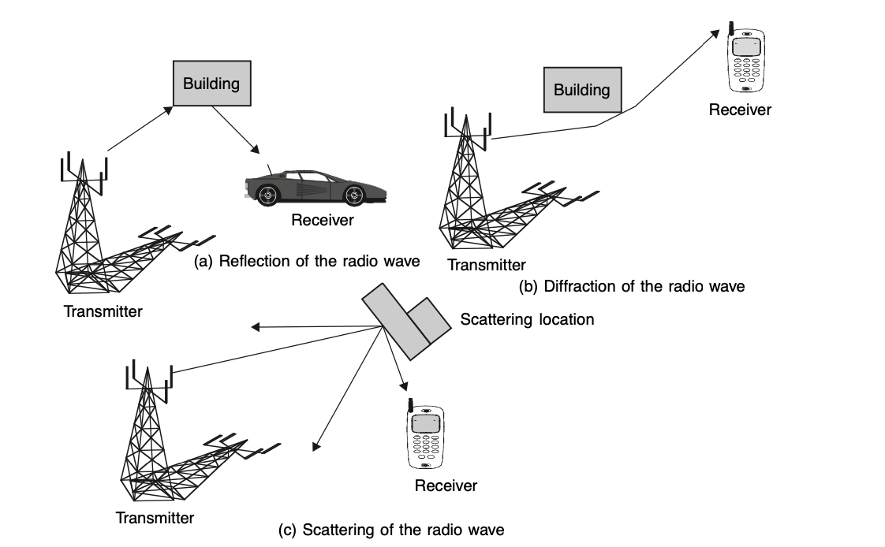
Signal Propagation
A signal radiated from an antenna travels along many ways (paths)
[Src: Chapter 1, Garg]

Slide 5
Terrestrial Propagation Modes
Each signal, depending on its frequency, predominantly travels in one of these modes.
Ground-wave propagation
Sky-wave propagation
Line-of-sight propagation

Slide 6
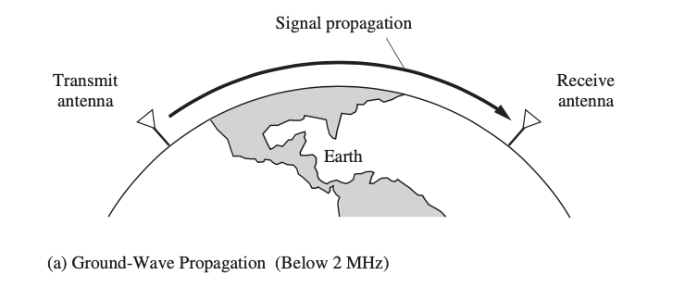
Ground Wave Propagation (below 2 MHz)
Follows contour of the earth
Can Propagate considerable distances
Frequencies up to 2 MHz
Example
AM radio
[Src: Chapter 1, Couch]
Notes:
more or less follows the contour of the earth and can propagate considerable distances well over the visual horizon

Slide 7
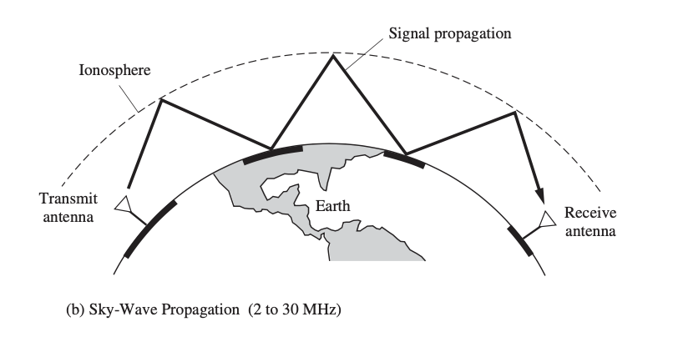
Sky Wave Propagation (2 to 30 MHz)
[Src: Chapter 1, Couch]

Slide 8
Sky Wave Propagation
Signal reflected from ionized layer of atmosphere back down to earth
Signal can travel a number of hops, back and forth between ionosphere and earth’s surface
Reflection effect caused by refraction
Frequencies 2-30 MHz
Examples
Amateur radio
International broadcasts, e.g., BBC & Voice of America

Slide 9
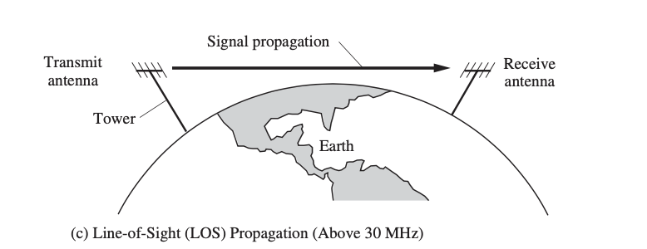
Line-of-Sight Propagation
[Src: Chapter 1, Couch]

Slide 10
Line-of-Sight Propagation (above 30 MHz)
Transmitting and receiving antennas must be within line of sight
Satellite communication – signal above 30 MHz not reflected by ionosphere
Ground communication – antennas within effective line of site due to refraction
Refraction – bending of microwaves by the atmosphere
Velocity of electromagnetic wave is a function of the density of the medium
When wave changes medium, speed changes
Wave bends once at the boundary between mediums
Wave bends continuously when traveling in a medium with variable refractive index e.g. atmospheric refractive index higher closer to earth surface

Slide 11
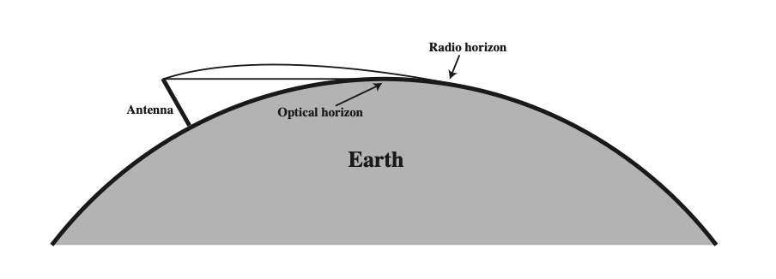
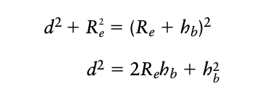
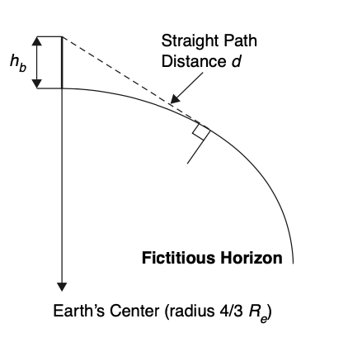
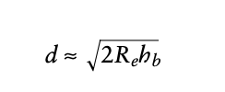
LoS propagation: Effect of earth curvature
R_{e} : (4/3) times actual earth radius
Notes:
Extent to two antennas

Slide 12
LOS Wireless Transmission Impairments for LoS communication
Attenuation and attenuation distortion
Free space loss
Noise
Multipath & Fading (we will cover in next class)
Notes:
We examine the various impairments and comment on their effect on the information carrying capacity of a communications link. Our main focus will be line of sight wireless transmission. The most significant impairments are as follows.

Slide 13
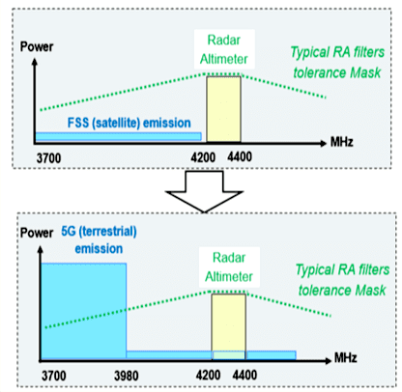
(all these impairments are even without other users’ interference)
Notes:
A graphic shown by AVSI's Andrew Roy during a Dec. 7 NBAA webinar shows power levels of the previous satellite emissions that were occurring in the 3.7–3.98 GHz band that 5G stations in the U.S. will start using next year.

Slide 14
1. Attenuation & attenuation distortion
Strength of signal falls off with distance over transmission medium
Attenuation factors for unguided media:
Received signal must have sufficient strength so that circuitry in the receiver can interpret the signal
Signal must maintain a level sufficiently higher than noise to be received without error
Attenuation is greater at higher frequencies, causing distortion
freq components of rcvd signal have different relative attenuation
solution using “equalizers” that equalize the attenuations across the frequency band

Slide 15
2. Free Space Loss
Free space loss, ideal isotropic antennas
P_{t} = signal power at transmitting antenna
P_{r} = signal power at receiving antenna
= carrier wavelength
d = propagation distance between antennas
c = speed of light (3 x 10^8 m/s)
where d and are in the same units (e.g., meters)
Notes:
You want this ratio to be small ie Pt as small as possible and power received as high as possible:
Ie increase the wavelength, decrease the frequency

Slide 16
Free Space Loss
Free space loss equation can be recast:

Slide 17
Free Space Loss
Free space loss accounting for gain of other antennas
G_{t} = gain of transmitting antenna
G_{r} = gain of receiving antenna
A_{t} = effective area of transmitting antenna
A_{r} = effective area of receiving antenna
Recall that:
Notes:
If you have directional antennas, each power has gain in a certain direction, so assume you use the direction of maximum gain in transmission and reception

Slide 18
Free Space Loss
Free space loss accounting for gain of other antennas can be recast as

Slide 19
Example 1
Find the received power for the link from a synchronous satellite to a terrestrial antenna. Use the following data: Height: 80,000 km. Satellite transmitted power: 8W. Transmit antenna gain: 20 dBi. Receive antenna gain: 60 dBi. Transmit frequency: 20 GHz

Slide 20
Categories of Noise
Noise is a major limiting factor in communication system performance
Unwanted signals in the medium are added to the intended signal at the receiver
Categories of noise:
Thermal Noise
Intermodulation noise
Crosstalk
Impulse Noise

Slide 21
3. Thermal Noise
Thermal noise due to agitation of electrons
Present in all electronic devices and transmission media
Cannot be eliminated
Function of temperature
Particularly significant for satellite communication

Slide 22
Thermal Noise
Amount of thermal noise to be found in a bandwidth of 1Hz in any device or conductor is:
N₀ = noise power density in watts per 1 Hz of bandwidth
k = Boltzmann's constant = 1.3803 x 10⁻²³ J/K
T = temperature, in kelvins (absolute temperature)
Notes:
e.g. room temperature is 17 degrees = 290 K.
N_0 = 1.3803 x 10^-23 x 290 = 4 x 10^-21 W/Hz = -204 dBW/Hz

Slide 23
Thermal Noise
Noise is assumed to be independent of frequency
Thermal noise (in watts) present in a bandwidth of B Hertz:
or, in decibel-watts

Slide 24
From E_{b}/N₀ to SNR (S/N)
Energy per bit, E_{b}=ST_{b} where S is signal power and T_{b} is is the time required to send one bit.
The data rate is just R=1/T_{b}.
The noise in a signal with bandwidth B is N=N₀ B.

Slide 25
Signal-to-Noise Ratio
Ratio of the power in a signal to the power contained in the noise that’s present at a particular point in the transmission
Typically measured at a receiver
Signal-to-noise ratio (SNR, or S/N)
A high SNR means a high-quality signal, low number of required intermediate repeaters
SNR sets upper bound on achievable data rate

Slide 26
Shannon Capacity
The maximum channel capacity in bits per second is
C = B log₂(1 + SNR)
where B is the channel bandwidth in Hz.
This result assumes white (Gaussian) noise, no attenuation or delay distortion.
Notes:
Shannon proved that if the actual information rate on a channel is less than the capacity, then it is theoretically possible to use a suitable signal code to achieve error-free transmission through the channel.
Note: as B increases, SNR decreases (because more noise gets into the system).

Slide 27
Example 2
Given a channel with intended capacity of 90 Mbps, the bandwidth of the channel is 8 MHz. What signal-to-noise ratio is required to achieve this capacity?

Slide 28
Intermodulation noise
may happen when the Tx, Rx or medium behave in non-linear ways
when signals at different frequencies share the same medium, non-linearities cause signals at sum or difference of original frequencies
these can interfere with legitimate signals at those frequencies

Slide 29
Crosstalk
unwanted coupling between signal paths
e.g. crosstalk in phone conversations

Slide 30
Impulse Noise
noise spikes of short duration and high magnitude
may happen due to lightning or other electromagnetic disturbances

